Slide 1
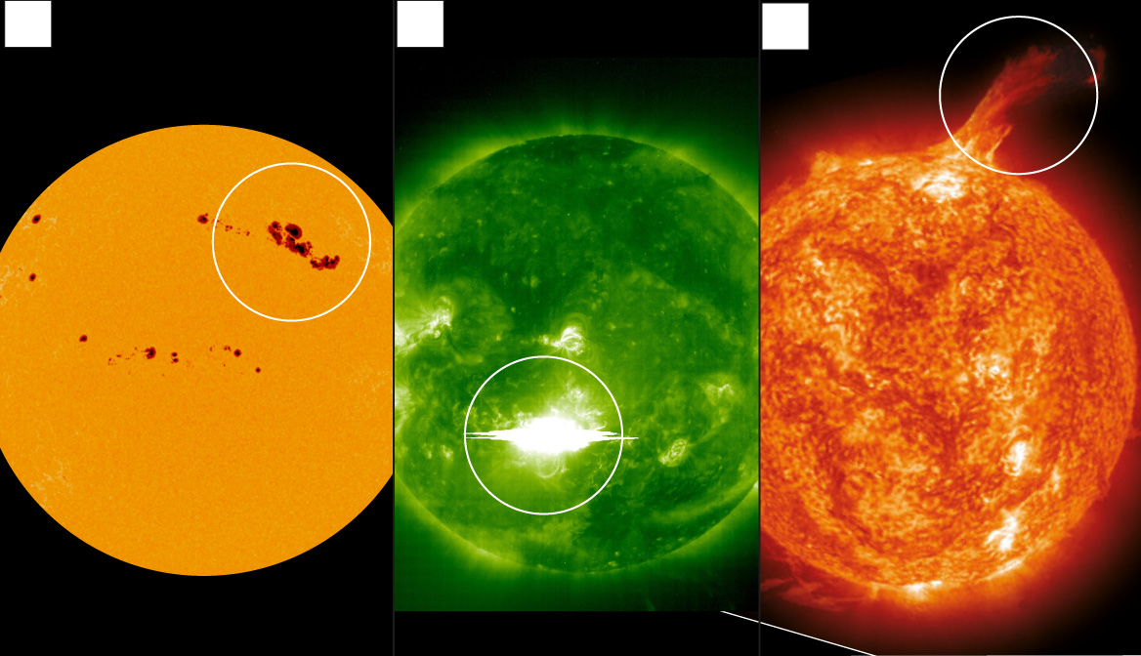
Motivation
Solar storm: Why the next disaster to strike will come from the sun (telegraph.co.uk)
Sun Spots Solar Flares CME
s

Slide 2
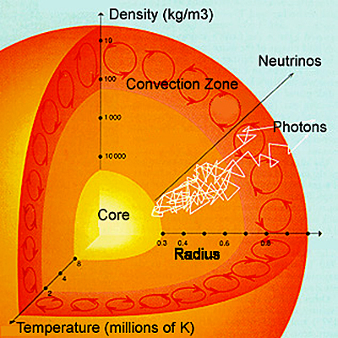
What are Solar Flares?
Solar flares are intense explosions of electromagnetic radiation from the Sun.
They are the solar system's largest explosive events and can release more energy than a billion hydrogen bombs.
Flares occur in active regions on the Sun, which are areas of intense magnetic activity.
Solar flares are thought to be caused by the sudden release of magnetic energy stored in the Sun's corona.
This energy release can occur when twisted magnetic fields become unstable and snap.
The energy released by a solar flare can heat the surrounding plasma to millions of degrees Celsius, and accelerate charged particles to nearly the speed of light
UH-DAIS

Slide 3
Solar Flares
Video Credit:
Keith Strong
@drkstrong
Solar physicist
A prominence erupting away from the E limb of the Sun at about 18:30 UT on 15 September.
Note how much of the plasma that was thrown off the Sun fell back onto the disk as it did not attain escape velocity (615 km/s).
UH-DAIS

Slide 4
Solar Flares and Earth
Solar flares can have a variety of effects on Earth.
The most immediate effect is the release of electromagnetic radiation, which can disrupt radio communications and damage electrical grids.
Solar flares can also accelerate charged particles, which can create radiation storms in Earth's atmosphere.
These radiation storms can pose a hazard to astronauts and airline passengers and can damage satellites and other electronic equipment.
In addition, solar flares can sometimes produce coronal mass ejections (CMEs), which are large clouds of plasma that can travel through space and impact Earth. CMEs can cause geomagnetic storms, which can disrupt power grids, damage satellites, and cause auroras. NASA spacecraft flies right through sun explosion, captures footage | Mashable
UH-DAIS

Slide 5
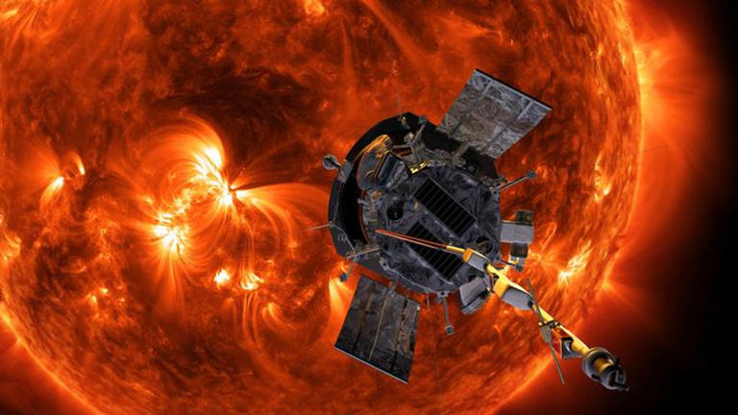
2023 Group Project
The 2023 DS1-TU⊕TH Group Project will center on:
Summarizing Solar Flares
Hotspot Discovery Involving Solar Flares
Mapping of Solar Flares and Solar Flare Summaries
Change Analysis Concerning Solar Flare Events
UH-DAIS

Slide 6
Additional Notes
Solar flares are classified according to their brightness in the x-ray wavelengths. There are three categories:
X-class flares are the most powerful solar flares. They can cause widespread radio blackouts and long-lasting radiation storms on Earth.
M-class flares are medium-strength solar flares. They can cause brief radio blackouts and minor radiation storms on Earth.
C-class flares are the weakest solar flares. They typically have little or no effect on Earth.
Solar flares occur more frequently during the peak of the solar cycle, which is an 11-year cycle of solar activity.
Scientists are still working to understand the exact relationship between solar flares and CMEs. However, there are indications that the two phenomena are closely linked.
For current Solar Weather, see: https://www.swpc.noaa.gov/
UH-DAIS

Slide 7
Helpful Links
Detailed Explanation of the Solar Cycle:
http://solarcellcentral.com/sun_page.html
NASA’s Parker Solar Probe spacecraft flies right through sun explosion, captures footage:
https://mashable.com/article/sun-solar-ejection-nasa-footage
Reuven Ramaty High Energy Solar Spectroscopic Imager was a NASA solar flare observatory. After more than 16 years of successful operations since its launch in 2002, RHESSI was decommissioned on 16 August, 2018.
https://en.wikipedia.org/wiki/Reuven_Ramaty_High_Energy_Solar_Spectroscopic_Imager
UH-DAIS

